Slide 1

ApproxIoT Approximate Computing for Edge Computing https://ApproxIoT.github.io/ApproxIoT/
Zhenyu Wen, Do Le Quoc,
Pramod Bhatotia, Ruichuan Chen, Myungjin Lee

Slide 2

Modern online services
Stream
aggregator
Stream analytics system
Useful
Information

Slide 3


Modern online services
Approximate computing
Tension
Low latency
Efficient resource
utilization

Slide 4
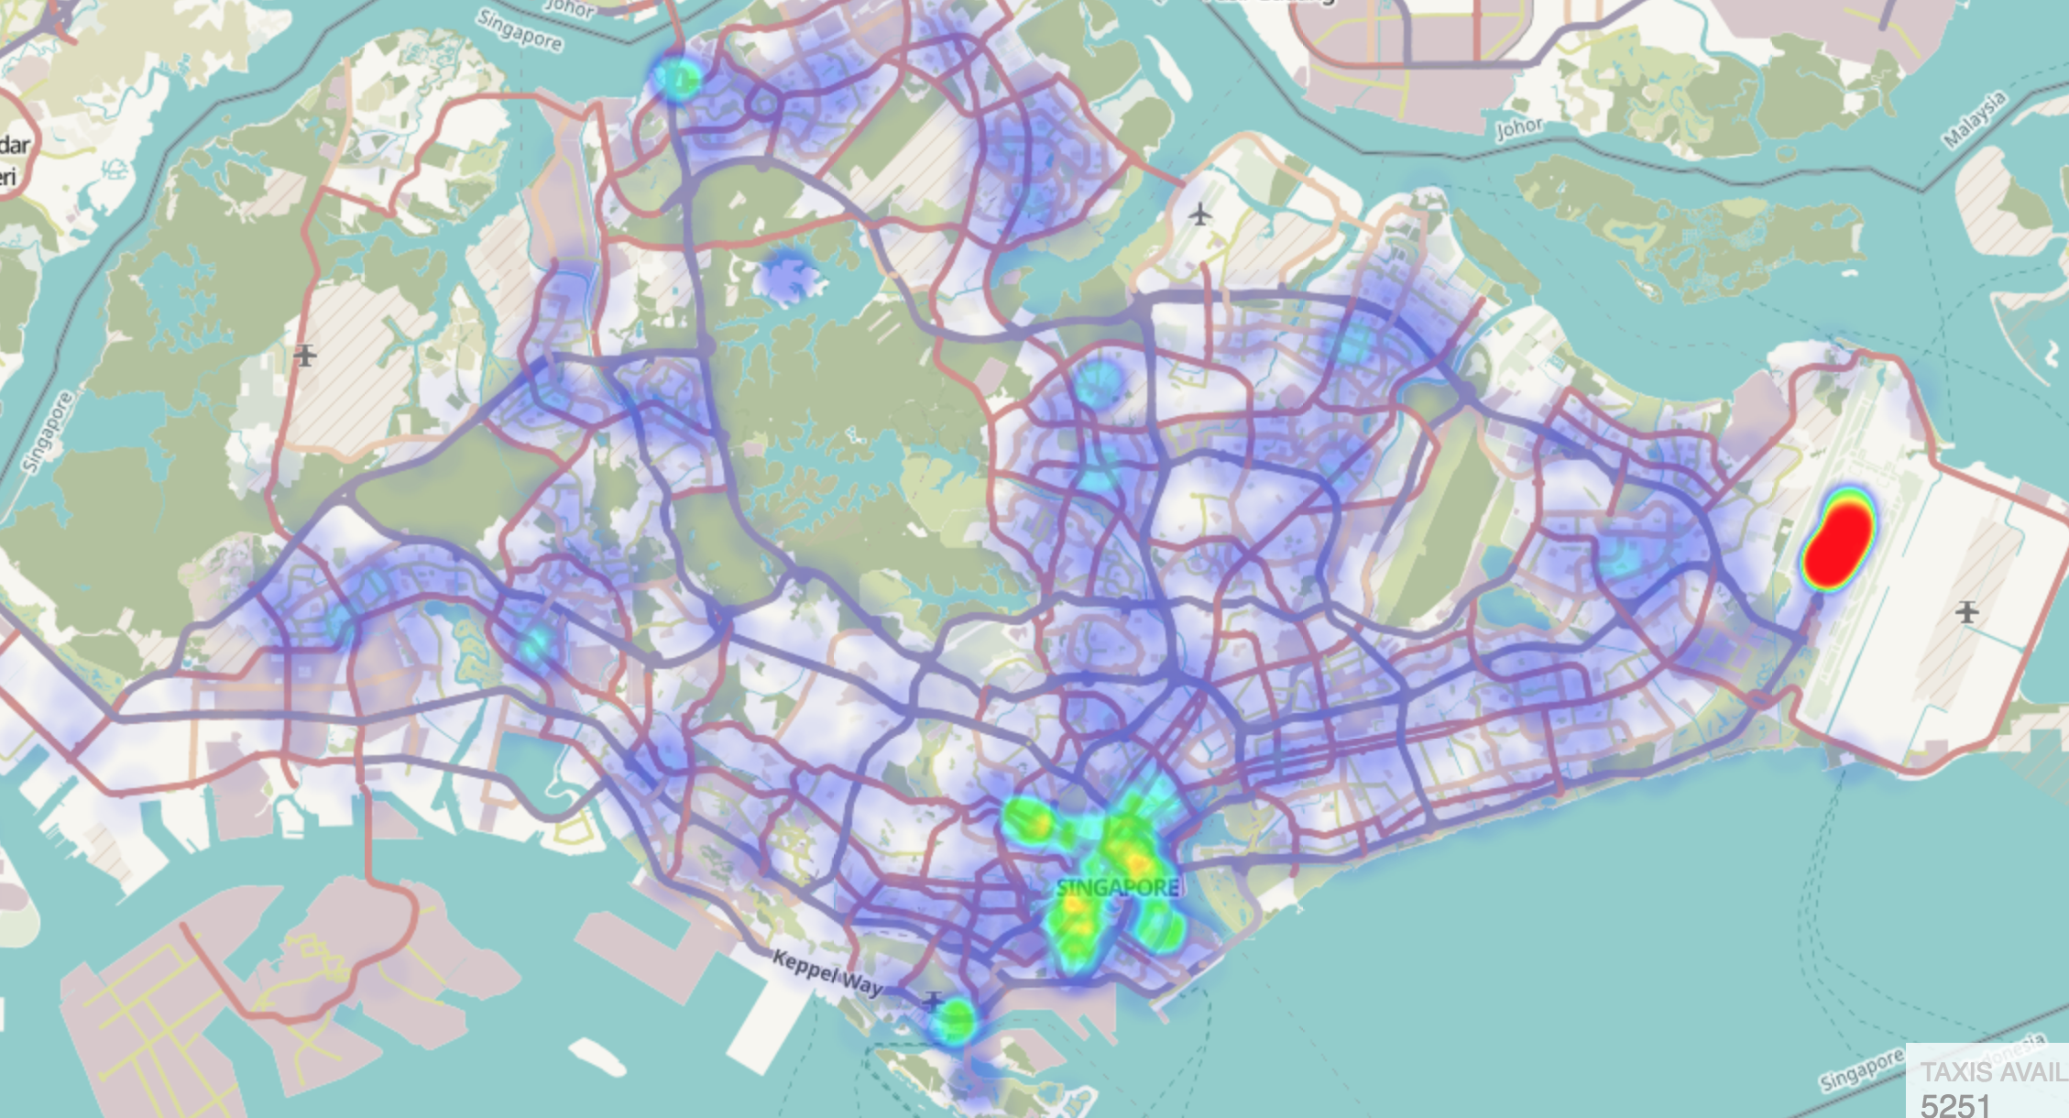
Approximate computing
Many applications: Approximate output is good enough!
The proportion of data is more important than the precise numbers
Live taxi heatmap

Slide 5
Approximate computing
Idea: To achieve low latency, compute over a sub-set of data items instead of the entire data-set
Approximate computing
(sampling)
Analyze
Approximate output ± error bound

Slide 6
State-of-the-art system
StreamApprox [Middleware’17]
S₁
Stream
aggregator
Data stream
S₂
StreamApprox
Approximate output ± error bound
…
S_{n}
Cloud datacenter
Limitations:
It wastes bandwidth
It utilizes only cloud resources

Slide 7




Edge computing
Allows data to be processed at the edge
node before it’s sent to the cloud
Source of data
Cloud
Edge node
Local processing
Gateway
Saves
bandwidth
Provides more resources

Slide 8

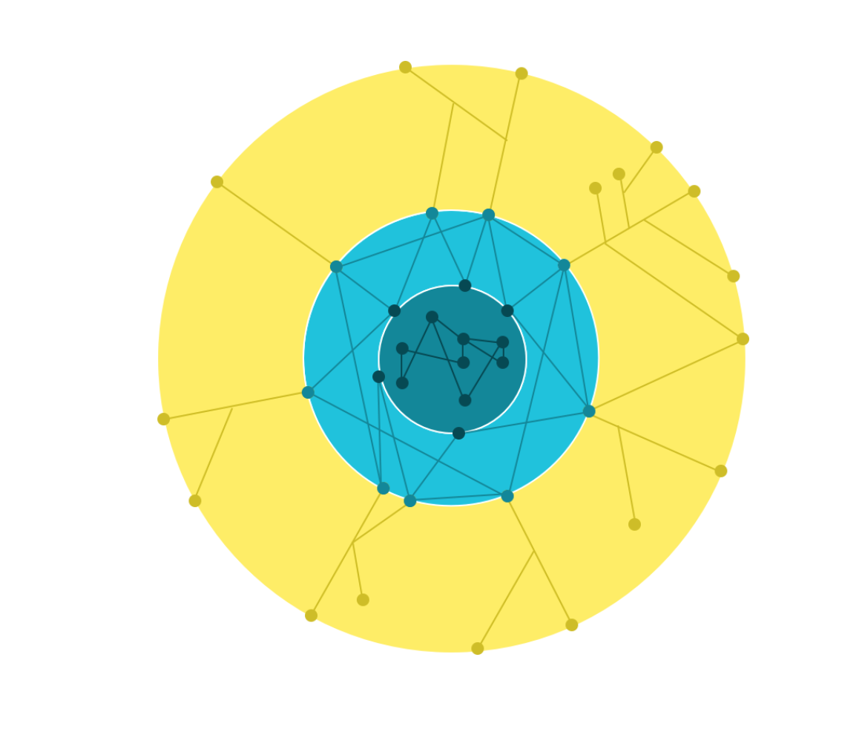


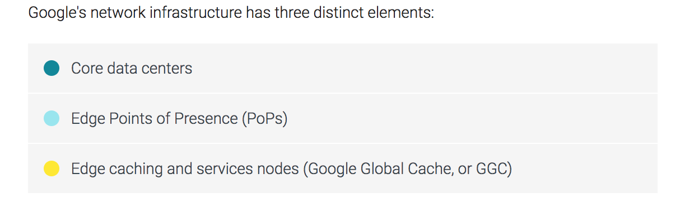

Edge infrastructure
Azure IoT edge
Watson IoT
AWS IoT
Source: https://peering.google.com/#/infrastructure

Slide 9
Problem statement
To build a stream analytics system
By utilizing the cloud and edge computing resources
By leveraging approximate computing
Design goals
Efficiency: Efficient utilization of computing resources
Adaptability: Adaptive execution based on the given budget resources
Transparency: Requiring no code changes

Slide 10
Outline
Motivation
Design
Implementation
Evaluation

Slide 11

ApproxIoT: Overview
Query and
budget
ApproxIoT
Edge nodes
S₁
…
Regional edge
Continental node
S_{i}
Cloud
…
Central node
S_{m}
Approximate output
± error bound
…
S_{n}
ApproxIoT employs sampling in the distributed environment of
edge + cloud

Slide 12
Naïve algorithm
Simple random sampling (SRS)
SRS
Query
Approximate output
Overlooked
Low accuracy

Slide 13
Background: Stratified sampling
Stratified sampling
Advantage: The sub-streams are selected fairly
Disadvantage: Requires the knowledge of each sub-stream size

Slide 14
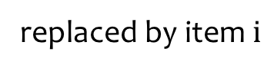
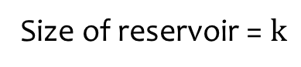
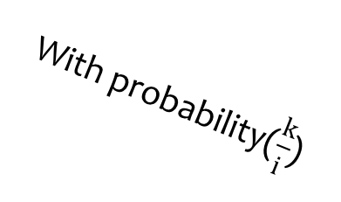
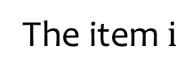
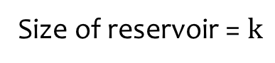
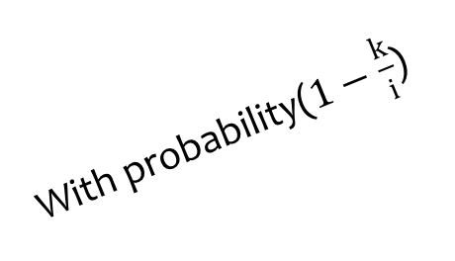
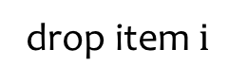
Background: Reservoir sampling
drop item $i$
The item $i$
With probability($1−\frac{k}{i}$)
Reservoir sampling
Reservoir sampling
Size of reservoir = $k$
With probability($\frac{k}{i}$)
replaced by item $i$
Size of reservoir = $k$
Memory efficiency: we only need to fit k items to memory

Slide 15
ApproxIoT sampling algorithm
Weighted hierarchical sampling (WHS)
Reservoir sample with size 3
The weight of the black sub-stream is updated
With initial weight 1
Reservoir sampling
W=1
W=4/3
W=1
W=1
W=1
W=1
Easy to parallelize, doesn't need any synchronization between sub-streams

Slide 16
WHS on edge nodes
Edge node1
Reservoir sampling
W=4/2
W=1
W=1
W=3/2
W=1
W=1
Edge node2
Reservoir sampling
W=2*4/2 =4
W=2
W=1
W=3/2
W=3
W=1
Easy to parallelize, doesn't need any synchronization between computing nodes
Reservoir sample with size 2

Slide 17
ApproxIoT in the cloud
The weights are carried
Reservoir sampling
Query (sum)
W=4/3
W=4/3*3/1 =4
W=1
W=1*3/1=3
W=1
W=1*2/1=2
Approximate output
4*
+3*
+2*
± error bound
(Central limit theorem)
Reservoir sample with size 1

Slide 18
Outline
Motivation
Design
Implementation
Evaluation

Slide 19


Implementation
S₁
See the paper for more details
S₂
Kafka
cluster
…
S_{n}
Data stream
Edge
nodes
Stream
pub/sub
Cloud
datacenter
Sampled
data stream
Sampled
data stream
Kafka Streams

Slide 20
Outline
Motivation
Design
Implementation
Evaluation

Slide 21
Experimental setup
Evaluation questions
Accuracy vs. sample size
Throughput vs. sample size
Testbed: 25 nodes
15 nodes for ApproxIoT deployment
10 nodes for Kafka cluster
Datasets:
Synthetic: Gaussian and Poisson distribution datasets
See the paper for more results!

Slide 22
Accuracy vs. sample size
The average is 0.035%
Lower
the better
ApproxIoT: ~2600X higher accuracy over SRS

Slide 23
Throughput vs. sample size
Higher
the better
ApproxIoT has low overhead compared to the native execution
ApproxIoT has similar throughput as SRS

Slide 24
Conclusion
ApproxIoT: Approximate analytics for edge computing
Efficiency
Efficient computing and bandwidth resource utilization
Adaptability
Adaptive execution based on budget and resources
Transparency
Requires no code changes and resource management
Thank you!
More details on the project website:
https://ApproxIoT.github.io/ApproxIoT/

